Slide 1

Unlocking CPU Secrets: An Experiential Learning Journey
Dive into the heart of modern computing with "CPU Architecture Visualizations," an interactive project designed to demystify the complex world of parallel processing and microarchitecture.

Slide 2

What is CPU Architecture Visualizations?
This web-based experiential learning project simplifies intricate concepts in parallel and processor-level computing through engaging visual simulations.
It's an interactive platform where theory meets practice, allowing you to explore the inner workings of CPUs firsthand.

Slide 3


KEY CONCEPT
Understanding Amdahl's Law
One of the core demonstrations, Amdahl's Law illustrates a crucial principle: the sequential portion of a program inherently limits overall performance improvement, no matter how many processors you add.
Even with infinite processors, a program that is 50% sequential can achieve at most a 2x speedup.

Slide 4
The Limits of Parallelism: Amdahl's Law in Action
Sequential Bottleneck
Diminishing Returns
Strategic Optimization
Highlights how a program's non-parallelizable parts cap its potential speedup.
Shows that adding more processors yields less benefit as the sequential fraction grows.
Emphasizes the importance of optimizing sequential code for maximum impact.
Through interactive simulations, learners can manipulate parameters and witness this fundamental principle visually.

Slide 5
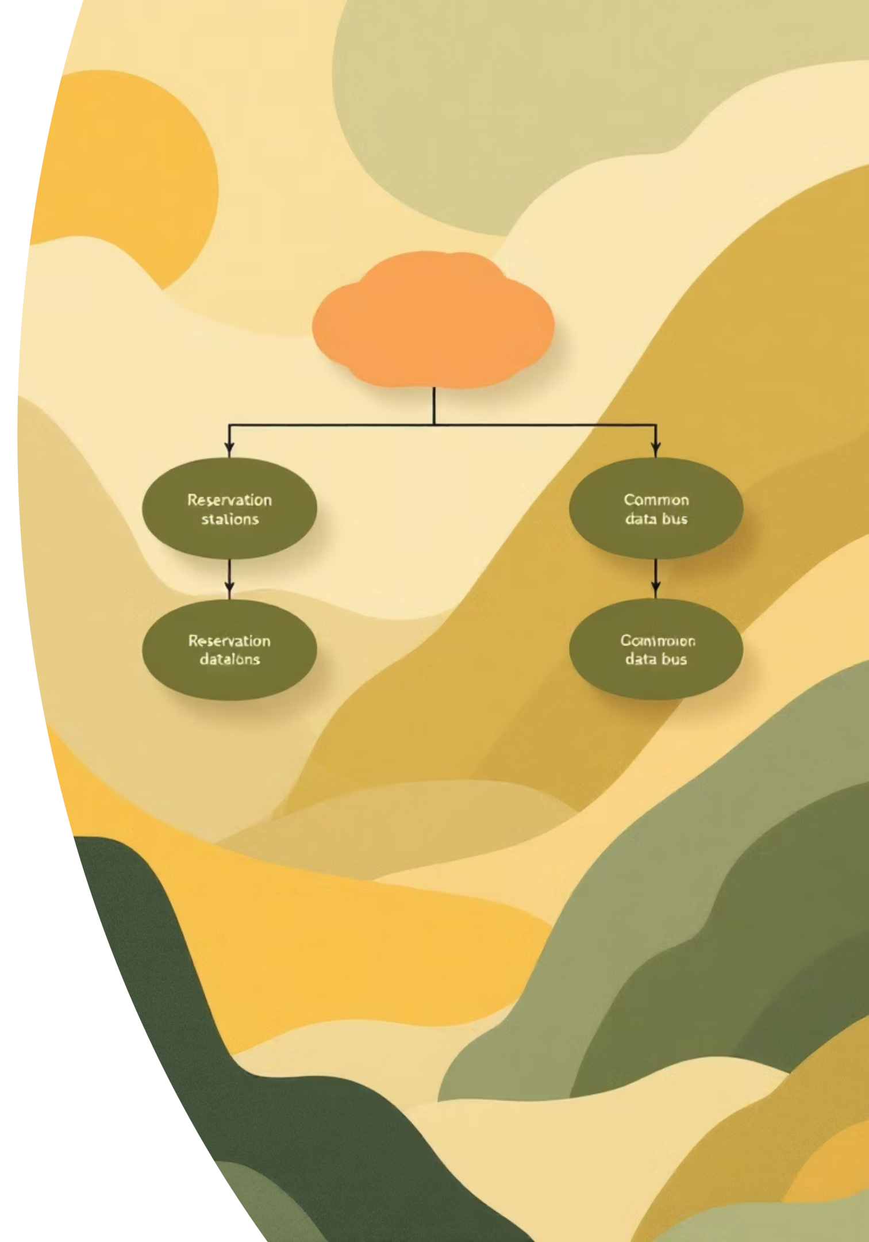
ADVANCED MICROARCHITECTURE
Demystifying the Tomasulo Algorithm
The project also provides a clear illustration of the Tomasulo algorithm, a cornerstone of modern processor design.
It reveals how CPUs achieve remarkable execution efficiency through dynamic instruction scheduling and out-of-order execution.

Slide 6
How Tomasulo Boosts Efficiency
01
02
Dynamic Scheduling
Out-of-Order Execution
Instructions are not executed in their original program order, but when their operands become available.
Allows later, independent instructions to execute before stalled earlier ones, preventing pipeline bubbles.
03
04
Reservation Stations
Common Data Bus (CDB)
Holds instructions and their operands, waiting for functional units to become free.
Broadcasts results to all waiting units and reservation stations, ensuring data consistency.

Slide 7
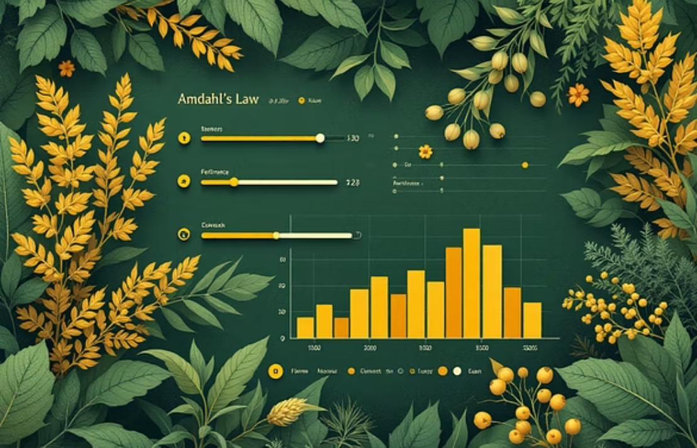


Interactive Learning: See It in Action!
The true power of this project lies in its interactivity. Users can adjust various parameters and observe the real-time visual behavior of these complex algorithms.

Slide 8



Key Benefits for Learners
Conceptual Clarity
Hands-on Exploration
Practical Application
Transforms abstract performance and CPU execution concepts into tangible, easy-to-understand visualizations.
Empowers users to experiment with different scenarios and see their impact immediately.
Helps connect theoretical knowledge to the practical implications in software and hardware design.

Slide 9



Who Can Benefit?
Undergraduate & Graduate Students
Educators
Self-Taught Programmers
Integrate interactive simulations into your curriculum to make complex topics more engaging and accessible.
Gain a deeper intuition for how your code interacts with the underlying hardware, leading to more optimized programs.
Enhance your understanding of computer architecture and operating systems with practical insights.

Slide 10



Start Your Exploration Today!
CPU Architecture Visualizations is more than just a tool; it's a gateway to mastering the intricacies of modern computing.

